Slide 1
SOA Design Patterns for EDW Delivery
Production-proven patterns that use service-oriented architecture to deliver functionality from the enterprise data warehouse
with James Madison

Slide 2
Agenda
About the speaker & the company
Design patterns to discuss:
  Enterprise Top-Level
  Pre-Integration
  Data Cacher
  Control/Indicator
  Data Tracer
  Data Cruncher
  File Drop
Other information
Q&A

Slide 3
About James Madison
Background experience
  17 years in IT
  11 years in Insurance
  10 years working on Oracle databases
  8 years in EDW and/or large-scale database systems
  4 years working in SOA
Currently an Architect responsible for
  The EDW in general—whether SOA or not
  SOA implementation focused on information management
Moonlight as adjunct professor
  Rensselaer Polytechnic Institute
  Instructor in the computer science and business programs
Email: MadJim@Bigfoot.com

Slide 4
About The Hartford
The Hartford Financial Services Group, Inc.
  One of the nation’s largest diversified financial services companies
  Fortune 100 company
  Founded in 1810
  31,000 employees
  Hartford Life – investment plans, Life insurance, Group benefits
  Hartford P&C – Auto, Home, Business insurance
    This presentation comes from auto insurance systems
Key Enterprise Technologies
  EDW started in 1996 and is undergoing several major enhancements as part of enterprise information management
  SOA adopted by business in 2004 and now aggressively driven across seven capabilities and five levels of maturity

Slide 5
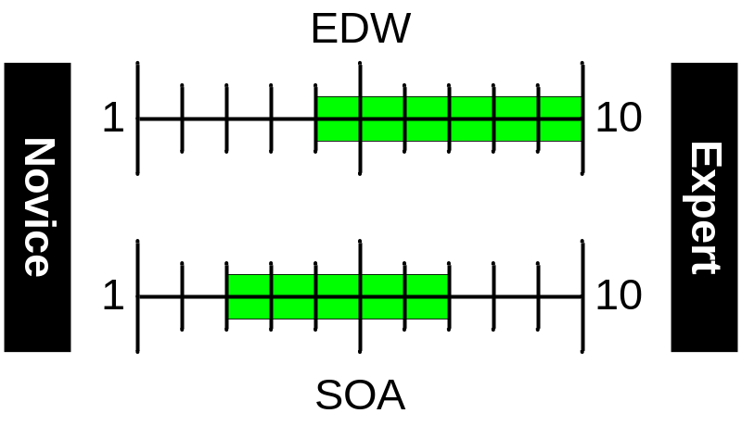
About You
Target audience:
  Solid knowledge of EDW
  Some knowledge of SOA
EDW Knowledge
  Familiar with supporting centralized assets
  Comfortable with the complexities of data
  Skilled with the tools for handling data
SOA Knowledge
  Beginners will find this presentation does not cover foundations
  Experts will find this presentation a straight-forward review of what they have already built themselves at some point
  Target audience members should (hopefully!) find a useful collections of patterns for managing data with SOA principles

Slide 6
SOA as Principles not Technologies
A “service” does not mean a “web service”
The “S” in “SOA” is about service qualities:
  Behavior agreed to through “design by contract”
  SLA’s defined and enforced
  Use of open protocols and industry standards
  Service can meet many client needs yet couple to none
  Security can be targeted to the role of the client
  Enterprise view shows high reuse and minimal redundancy
The implementation technology can vary widely
  For example: FTP, file watchers, shared directories
  These are all typical EDW items
  Yet they can be used according to all SOA principles

Slide 7
Pattern: Enterprise Top-Level (1 of 7)
Objective: To connect SOA and EDW at a high level
SOA and EDW have several important things in common
  Reusable across multiple areas of the company
  Consistent, standardized methods of connecting other systems
  System behavior enforced by agreements across departments
  Security constraints to prevent unauthorized access
Result: EDW systems are well positioned for SOA
But “traditional” SOA and EDW have some differences
  Pro: EDW can handle volumes far beyond traditional SOA
  Pro: When SOA is solving a “data problem” EDW can do it better
  Con: H.A. and D.R. for SOA much more demanding than for EDW

Slide 8
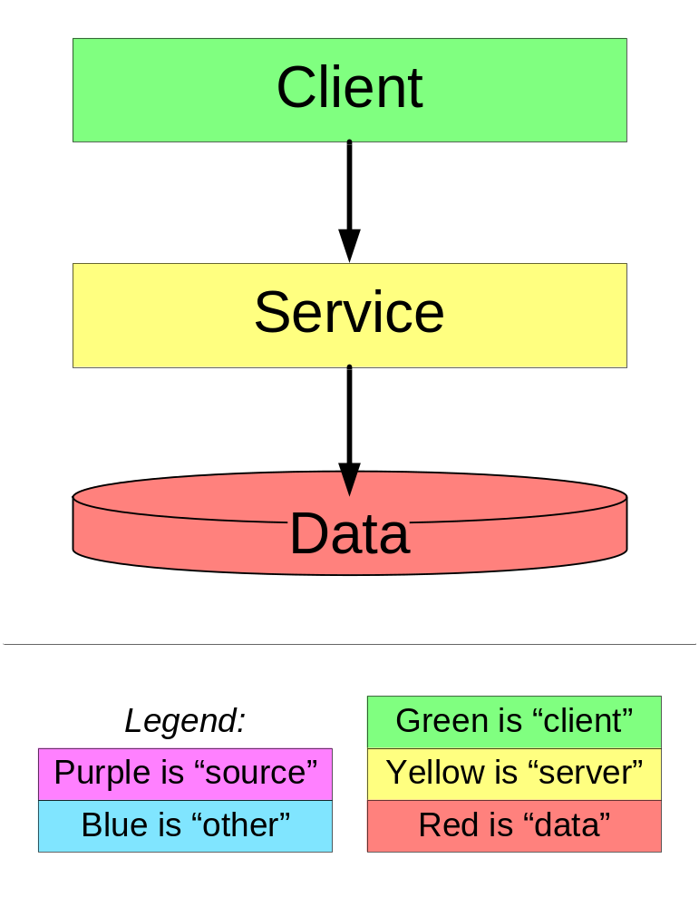
Simplified Service Model
A client system needs the functionality of the service
The client makes a call over the network.
The service receives the call and services the request
In so doing, the service performs any logic and retrieves any needed data.
The three components can each be anywhere on the network

Slide 9
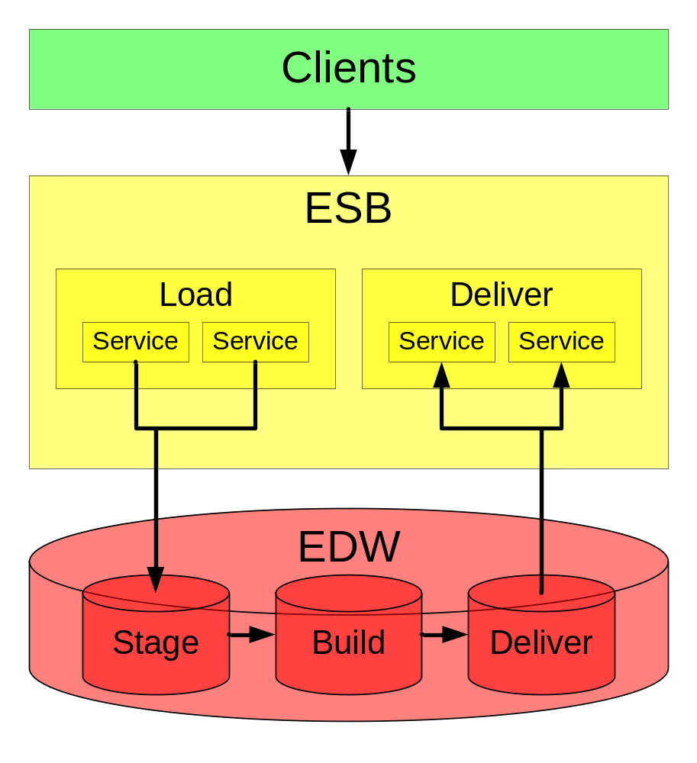
EDW as the Data for Services
Many clients need data
The clients call any number of data services
The services’ are accessed through the Enterprise Service Bus
The services use the EDW for the data
Services can load or deliver; delivery is our focus here

Slide 10
Enterprise Service Bus Functionalities
An ESB is a set of functionality that:
  Is needed by many services
  Should not be done by any service itself
Regardless of how it is implemented, and ESB provides:
This discussion assumes a broader SOA team handles the ESB implementation for the EDW team
Routing | Transformation
Orchestration | Transaction management
Security components | Guaranteed delivery
Registration & lookup | Monitoring & management
Publish/subscribe | And so on…

Slide 11
Pattern: Pre-Integration (2 of 7)
Objective: perform integration in most optimal location
Industry recognizes three major ways to integrate:
  EAI – Enterprise Application Integration
    Integrate at the application level
  EII – Enterprise Information Integration
    Integrate information in simple ways at small volumes
  ETL – Extract Transform Load
    Integrate information in complex ways or at large volumes

Slide 12
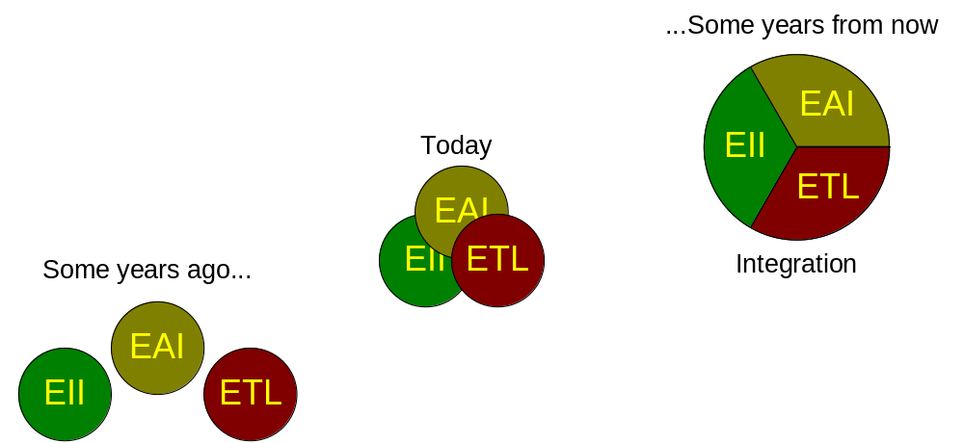
Integration Trending in the Industry
The three methods are merging because they are solving the same problem – integration:

Slide 13
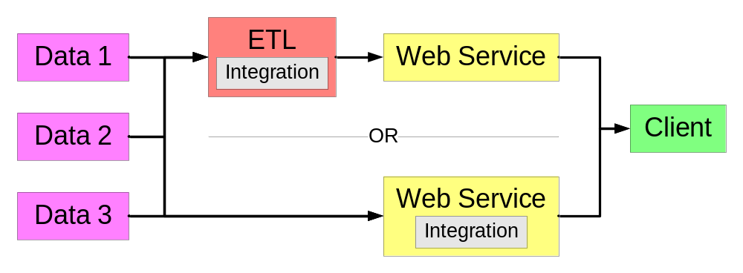
Example of Two Integration Options
Example: options to bring together three data sources for a single data service:
Could do:
  Integration of 3 sources at ETL with light-weight service
  Integration in heavier-weight service and no ETL
  Some combination based on the specific situation

Slide 14
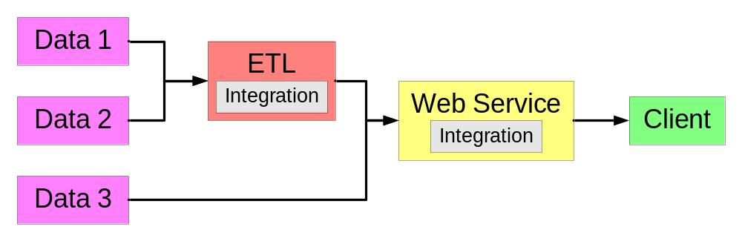
Final Solution: The Best Hybrid
Solution: used ETL for two sources, EAI for third:
Sources #1 and #2 were data feeds from vendors
  Real-time reads of data from web service was very viable
  But ETL integration was used due to rules of this pattern
Source #3 was an existing MQ interface to the data store
  Used ESB to create HTTP POST and wrap with WSDL

Slide 15
Other Pre-Integration Information
In general, lean toward ETL to do data work
  Compared to others, ETL is more durable, easier to troubleshoot, has no volume limitations, and is moving into the other spaces faster than they are moving into ETL
Then make the service a light “wrapper” to just deliver the data integrated by the ETL layer
  This keeps the SOA coding so light that the ETL tool can probably do it out-of-the-box
But do not always force an ETL solution
  Lean toward EAI if application code/logic dominates data
  Lean toward EII if data need is light and quick to build

Slide 16
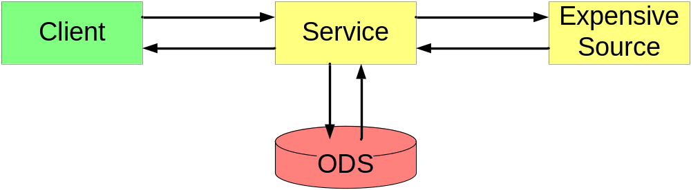
Pattern: Data Cacher (3 of 7)
Objective: avoid expensive operations by caching and reusing data
When using an expensive source, check ODS first
If not in ODS, go get it, then save it for next time
“Expensive” can be measured by time or money

Slide 17
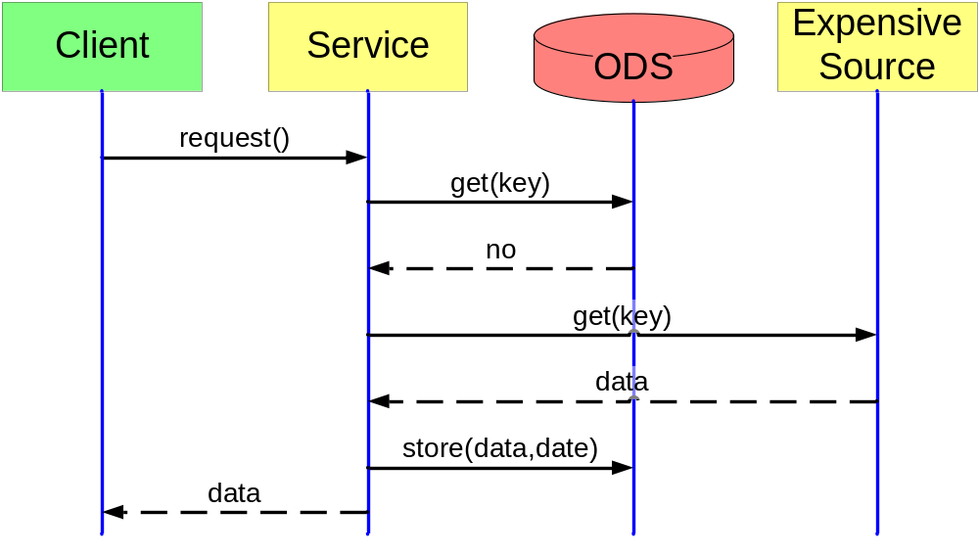
Caching Flow When Not Cached
Check database, retrieve if missing, cache, return

Slide 18
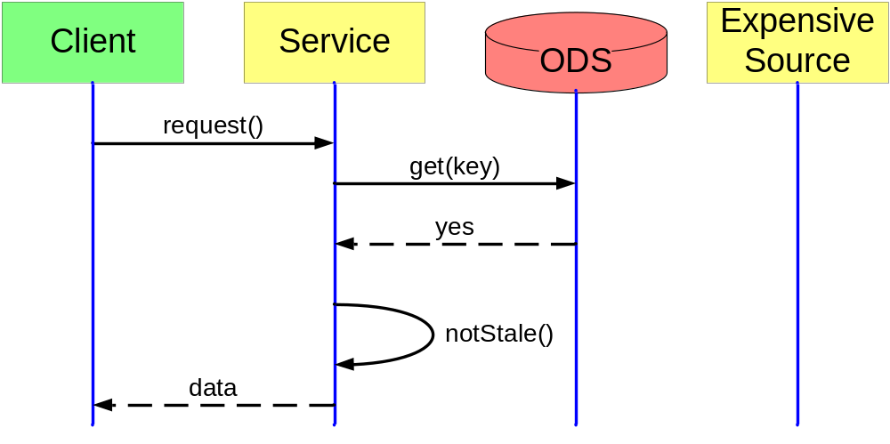
Caching Flow When Cached
Check database, find it, verify not stale, return
(If it is stale, retrieve it per the previous diagram)

Slide 19
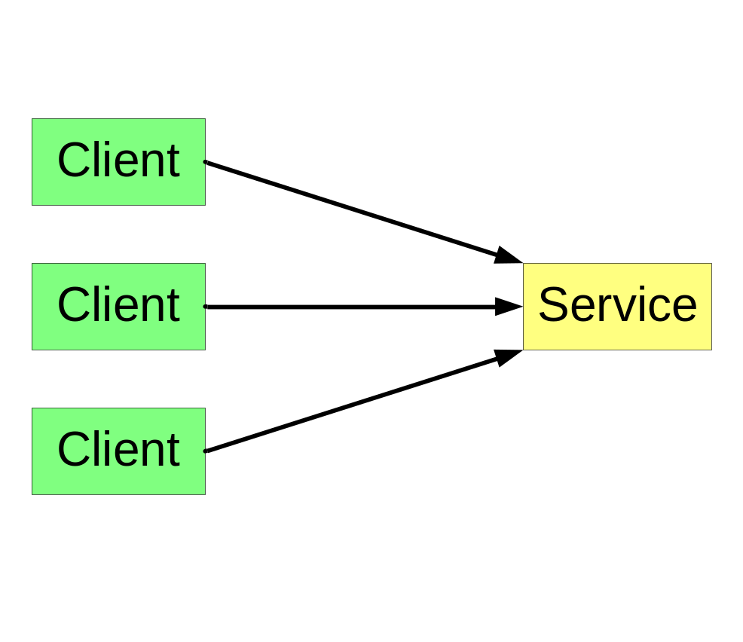
Pattern: Control/Indicator (4 of 7)
Objective: Let clients customize service behavior
Multiple clients have a similar need
However, they have slightly different variations on the need
For example, driver history reports are ~$7 per call, so should reuse
But legal or processing requirements may force getting latest and greatest

Slide 20
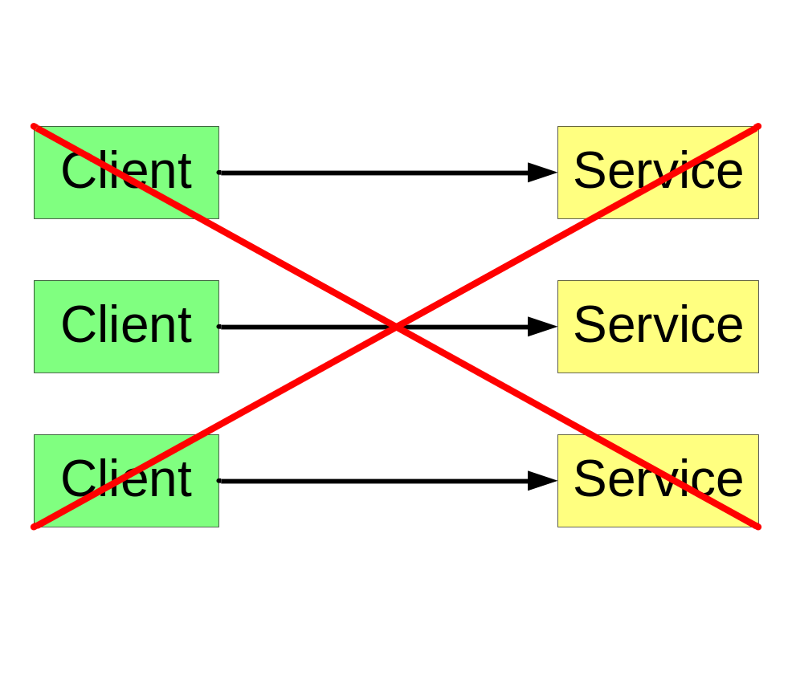
How Not to Meet Specific Client Needs
What we absolutely do not want to do is produce multiple custom services
Instead, we provide the client with a way to pass in parameters that control service behavior
And we return a set of indicators that quantify how the service behaved

Slide 21
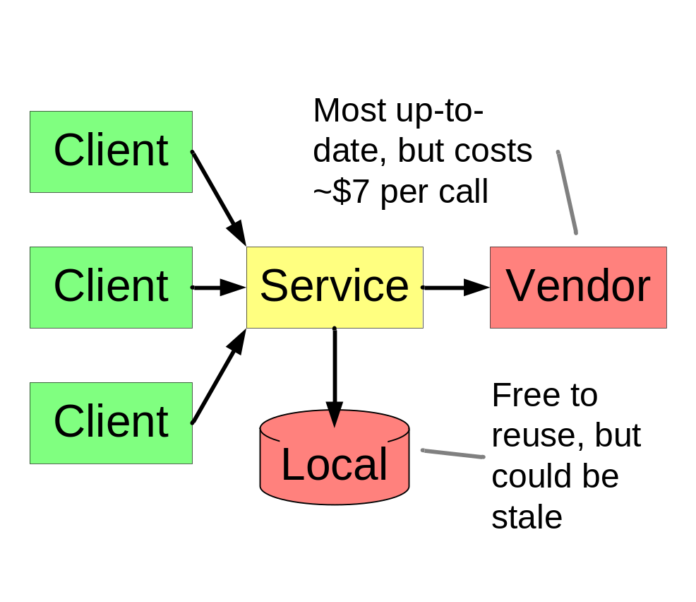
Example of Valuable Client Control
Do Local, not vendor
  Nice-to-have data
  But not worth $7
Try local, then vendor
  Must-have, ok if not current
  Try to save the $7
Force to vendor
  Must have latest data
    Compliance
    Risk mitigation

Slide 22
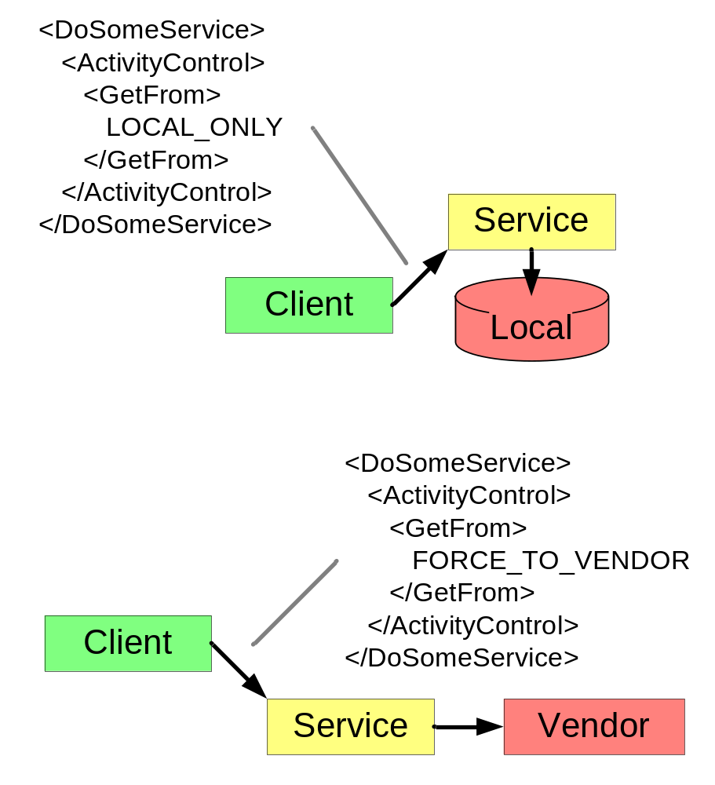
Contents of Client Control
Add parameter sections
  <ActivityControl>
Can have multiple such sections
Best at multiple levels
  Global example
    <PartialResults>
  Local example
    <GetFrom>
      Per-unit basis

Slide 23
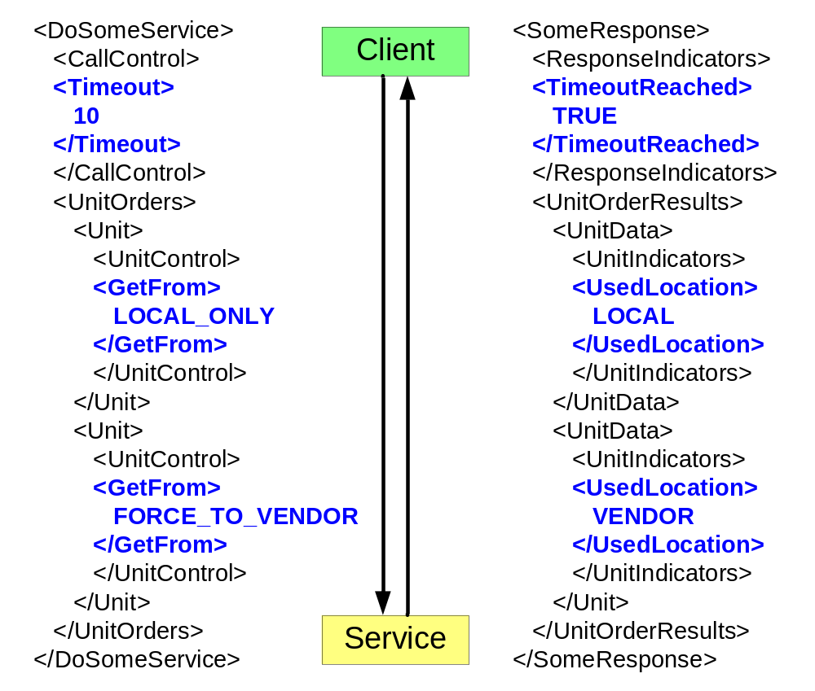
Control/Indicator Pairings
Client needs to know specific behaviors
Service returns indicators
Fairly 1-1 but not absolutely
Usually more indicators than controls

Slide 24
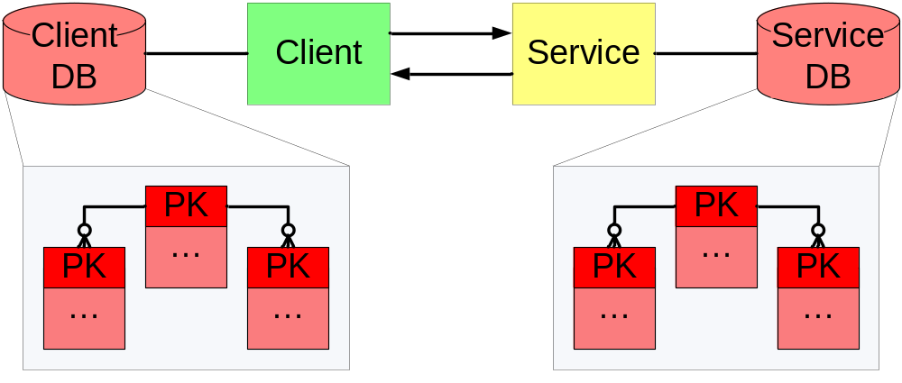
Pattern: Data Tracer (5 of 7)
Objective: To trace and integrate data from SOA activity
Services by design are transient or “stateless”
Solution uses the databases of the client & service

Slide 25
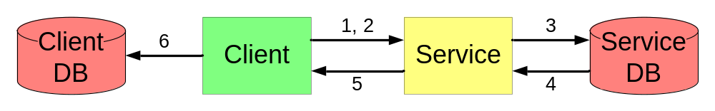
What Flows in a Data Tracer
Service provides fields for client to populate
Client passes its PKs that identify its side of the activity
Service stores PKs as attributes of the transaction
Service reads its own PKs for entities in the transaction
Service PKs are returned to the client
Client can store service PKs as needed

Slide 26
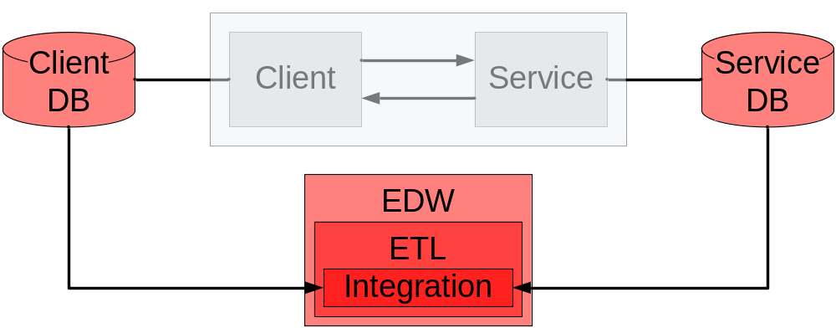
Using the Tracing Data Later
Now when integration must occur in the future, it is easy
Assume a driver report generated from the service and a quote from the policy writing system have to be brought together in the EDW:

Slide 27
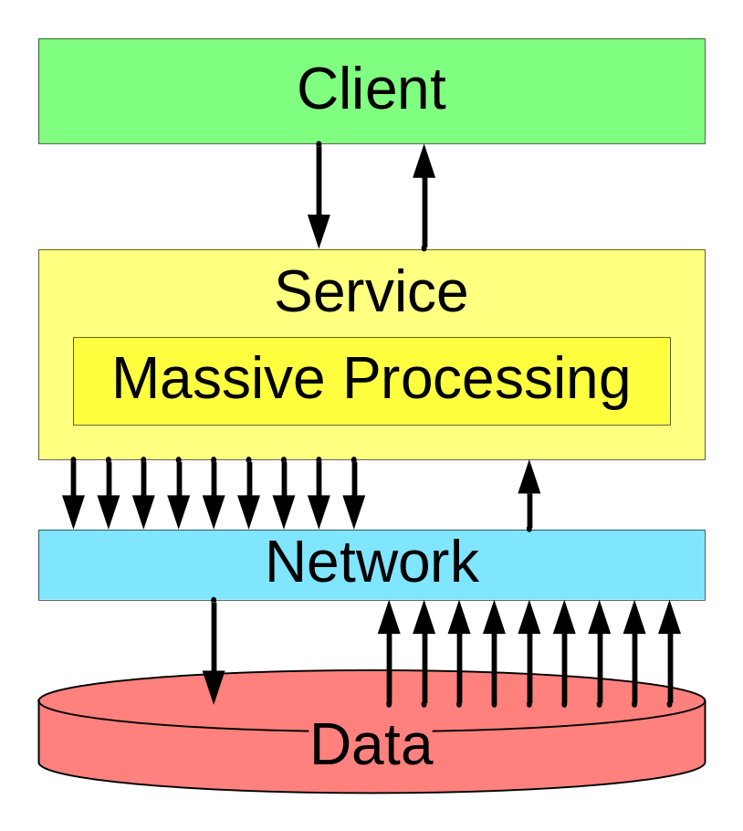
Pattern: Data Cruncher (6 of 7)
Objective: Run heavy calculations efficiently as a service
Service design should start with the usual layering
But what if the service logic is extremely I/O intensive?
Hopping between the service logic and data can slow performance and swamp the network

Slide 28
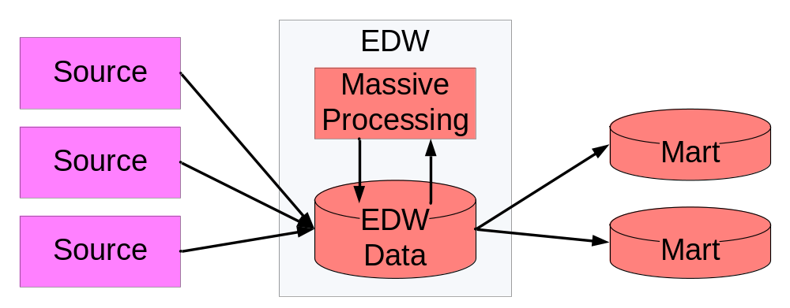
Leverage the EDW’s Crunching Capacity
The solution is to move the processing to the data layer
At a very high level, we already do this in an EDW:
Traditional EDW systems avoid massive cross-network processing; likewise with services

Slide 29
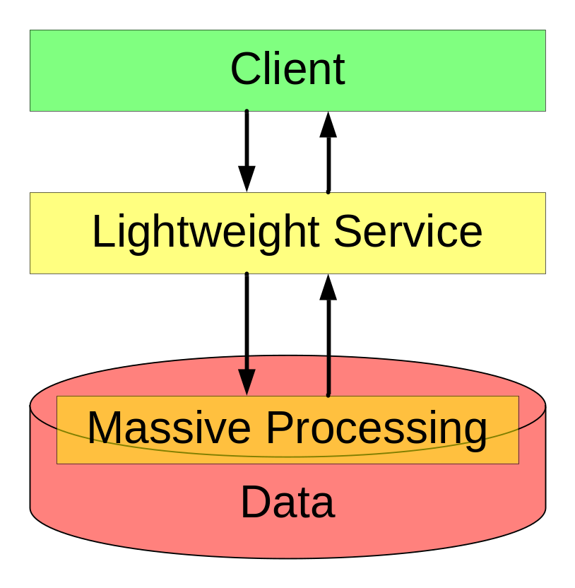
Where to Put the Crunching Logic
Instead, move the heavy processing to the data layer
The service becomes a very lightweight interface into the heavy processing
This assumes heavy processing but light I/O at the client level
If the client I/O is heavy as well, see the next pattern

Slide 30
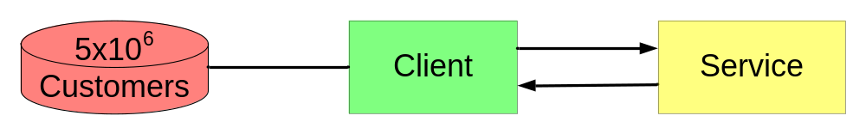
Pattern: File Drop (7 of 7)
Objective: Efficiently handle massive call volume
A “service” does not necessarily mean a “web service”
Running 5 million web service or MQ transactions is brutal
Even if “chunked” to 50 per call, it’s 100,000 calls
  Still quite scary for the network and ESB support teams
But as a file transfer, it’s only a few gigabytes
  Not a scary file size for EDW support teams

Slide 31
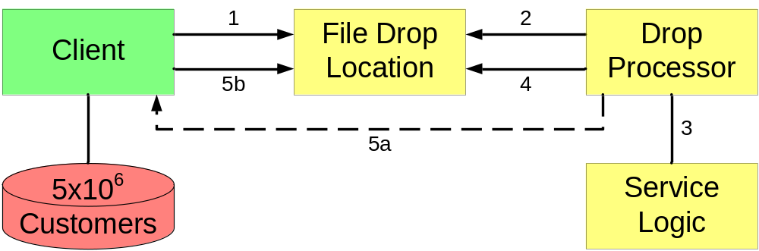
Events in a File Drop
Client drops a file in a defined format at a location
Service file watcher sees that and picks it up
Service runs the needed service logic per record
Service puts the processed file in the drop location
Client can a) get a callback, or b) poll the location

Slide 32
Key Challenges & Lessons Learned
Development is far more than “auto-generate everything”
  Many SOA tools can generated basic services
  Nearly every one we’ve encountered needs much work beyond that
Implementation matters
  is about the logical level.
  Implementation still drives performance, scalability, DR, etc.
Fully generic design and client agnostic reuse is hard
  Clients always start out asking for proprietary service functionality
  Most can easily be made generic, but some is hard to make so
Tool maturity is limited
  Useful features of industry standards not implemented
  Memory limits, threading behavior, server crashes, etc.
SOA is powerful, useful, but oversold; approach rationally

Slide 33
SOA Design Pattern References
Various books on the subject
  Enterprise Integration Patterns by Hohpe & Woolf
    Provides 60+ patterns that can be mixed & matched
    Well diagrammed, and available as a Visio template
  Data Access Patterns by Nock. About data, though not SOA per se
  Design Patterns by Gamma, Helm, et al. The classic!
Internet search on “SOA Design Patterns”
  There are about a dozen books that cover the subject
    Most are in works that cover all of SOA, not just design patterns
  There are dozens of articles
    Many useful to varying degrees
  Difficult to find many works specifically targeted to applying SOA to large data volumes using common EDW tools

Slide 34
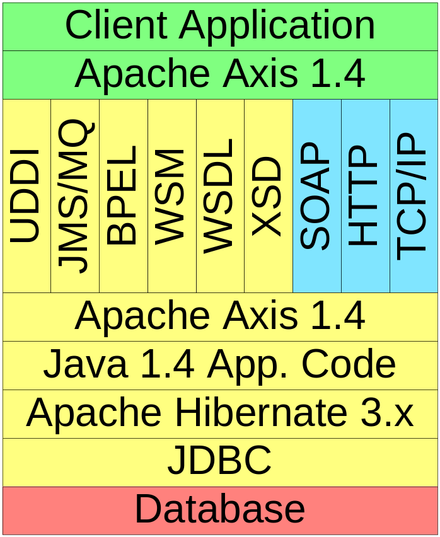
Technology Stack for a Service
This is a design pattern discussion, so technologies are not the focus
But a quick view of the technology stack can be helpful to prevent the “vaporware” feel
To the left is one possible stack of tools for building many common SOA functionalities

Slide 35
Q&A
Anything else?

